Slide 1
状语从句综合讲解一
时间/原因/条件状语从句
茜茜老师

Slide 2
目录
01.
状语从句综述
02.
时间状语从句
03.
原因状语从句
04.
条件状语从句

Slide 3
一，目标：
整体了解状语从句，具体学习掌握时间状语从句，原因状语从句和条件状语从句，
能够解决相关题目，并在写作中加以运用。
考点：状语从句区别于宾语从句和定语从句，不用分析从句成分，一般理解前后两个句子的语境，
掌握两者的关系，即可选出答案。
最重要的是时间，条件状语从句

Slide 4

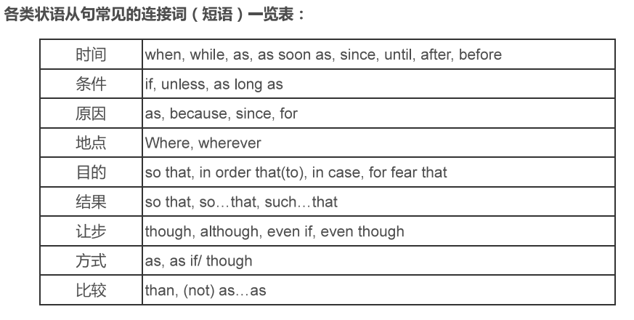
二，知识讲解
1，状语从句综述
状语从句即在主从复合句中做状语，可以用来表示时间，条件，原因，地点，目的
结果，让步，方式，比较等这九大类，在句子中可修饰谓语（或其他动词），
形容词，副词或整个句子。
注：状语从句的作用相当于
副词，故也可称之为副词性
从句。

Slide 5
2，时间状语从句
用表示时间的连词连接一个句子作状语 ,这样的主从复合句就是时间状语从句。
引导时间状语从句的连接词主要有when, while, as, before, after, since, tll/until,
as soon as等。 [特别注意]时间状语符合“主将从现"的要求。
when/while/as
( 1 )连词when, while和as都可表示“当....时候”,但用法有区别:
①when既可表示某一时间点,也可以表示某一段时间:其谓语动词可以是延续性的,也可以
是非延续性的,可与主句中的谓语动词同时发生,也可在其后发生。
eg. I was just reading a book when she came into my room. ( came为非延续性动词)
她来我房间的时候,我正在读书。
When the sun rises, the farmers work in the fields. ( work是延续性动词)
当太阳升起的时候,农民们在田里劳作。
②while只能表示某一段时间,其谓语动词只能是延续性的,而且也只能与主句中的谓语
动词同时发生或存在。
eg. While Jim was mending his bike, Lin Tao came to see him.
While Lin Tao came to see him, Jim was mending his bike. ( x )
When Lin Tao came to see him, Jim was mending his bike. ( V）

Slide 6
③as意为"一...- .."或....同时“,重在表示动作同时发生、伴随进行。
eg. As time passes by, she is no longer what she used to be.
随着时间的推移/流逝,她不再是之前的她的了。
[练习]用适当的连词填空:
( 1 ) While she is cooking in the kitchen, he is watering in the garden.
(2 ) He sang as he walked on the way home.
( 3 ) When he came in, we were talking loudly.
(4) When/While I lived there, I used to go to the seaside on Sundays.
( 5 ) When we got to the bus stop, the bus had left.
( 6) Pay attention to your eyes when/while you are reading.
( 7 ) As he grew older, he became more itelligent.
备注
②中例句中的mend与repair同义,都表示修理。
③例句有一般现在时和一般过去时均可，itelligent可以表示"聪明的，智慧的“,在写作
中可以代替clever。
延续和非延续性动词:
动词按其动作发生的方式、动作发生过程的长短,可分为延续性动词和短暂性动词。

Slide 7
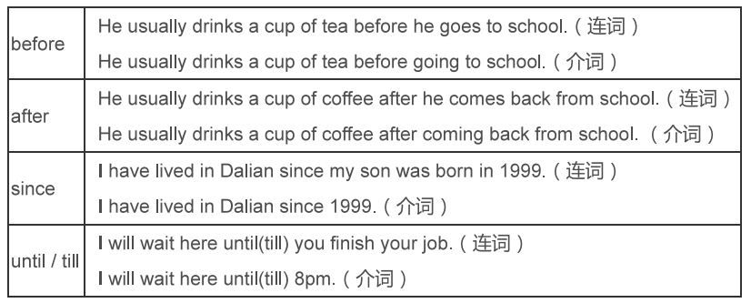
延续性动词是指表示能够延续的动作，如：study，work, stand, lie ,know ,walk , keep ,have , wait
watch ,sing , read ,sleep 等。
非延续性动词即短暂性动词表示不能延续的动作，这种动作发生后立即结束。如：open, close ,die
begin,start, finish , come , go , move ,borrow 等。
before/after/since/as soon as
这几个连词，当他们表示时间时，既是介词又是连词

Slide 8
( 2 ) before表示“在..之前”, after表示“在...之后”。如:
例①:He had lived in Japan for fifty years before he moved here.
After he had lived in Japan for fifty years, he moved here.
before的使用很灵活,还有其它的意思:
②"尚未来得及”
---Why didn't you tell him about the meeting?
--He rushed out of the room before I could say a word.
③"趁...”,“没等..就.....”
You should do it before it is too late.
趁现在还不算太晚,你应该赶快做它。
He made a mistake, but then he corrected the situation before it got worse.
他出了差错,但没等其进一步恶化,他就调整了局势。
句型对比:
①It + wil/would/may be +时间段+ before.. .表示“要过多久/也许要过多久... ,其否定形式It will would not be +时间段+ before.. ”表示“不久就.... ,过不了多久就....如:
It will be three months before we meet them again.
It will not be long before we know the result of the exam.
②It was +时间段+ before..."表示“过了(多长时间) .....其否定形式“it was not +时间段
+ before ...”意为“不久就...”..“没过(多长时间) ....。如:
It was long before they found their son.

Slide 9
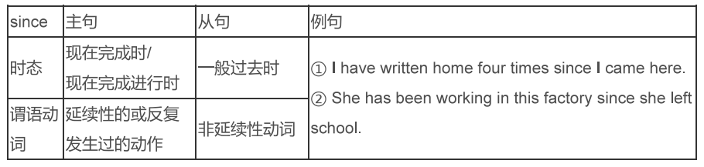
(3) since表示“自从”,通常用法如下:
[特殊句型] Itis +一段时间+since...的句型与It has been +一段时间+since...意思相同。
如: It is/has been three years since the war broke out.
自战争爆发以来已有三年了。
注意:在这种结构中, since引导的从句绝对不能用否定式的谓语动词来表示否定意义。如:
他好久沒学英语了。
It is a long time since he didn't study English. ( 误)
It's a long time since he studied English. (正)
( 4 ) as soon as可译为......... ,用来表示主从句的动作是紧接着发生的。它的特点是,
在句子中的位置比较灵活,而且可以用于各种时态。
eg. As soon as she finishes her homework, she will play tennis. ( 主将从现)
He rushed home as soon as he got the good news. (主过从过)

Slide 10
( 5 ) until, til都表示“直到”,它们唯一的区别是: tll不能置于句首。
( 1 )肯定句:主句的谓语动词必须是延续性动词的肯定式,意为“某动作一直延续到某时间点才
停止”。如:
He remained there untiltill she arrived.
(2)否定句:主句的谓语动词必须是非延续性动词,意为“某动作直到某时间才开始”。如:
He won't go to bed tll/until she returns.
3.原因状语从句
连接原因状语从句常见的的连接词有because, since, as和for
(1) because
①because表示的原因是必然的因果关系,语气最强,通常放在主句之后。
eg. Iwas absent from the meeting because | was il.
②回答why提出的问题,只能用because,不能用其余三者。
eg：
A: Why can'tl go?
B : Because you are too young.
(2) as意为"由于”表示附带说明的双方已知的原因" ,可放在主句前或主句后。
例: As it is raining. we decide not to go to the park.
由于下雨,我们决定不去公园了。
注意否定形式，有的时候前面句子比较长，
容易忽略前面的not

Slide 11
( 3) since引导的从句表示已知的、显然的理由(通常被翻译成 既然"= now that )。
例: Since she is very busy, I won't disturb her any more/l will leave her alone.
既然她很忙,我就不打扰她了。
Now that everyone is here, let's start to discuss the question.
既然大家都到了,咱们开始讨论这个问题吧。
( 4 ) for表示一种推理或解释,或用作附加说明, 一般不放在句首。
He must be home now, for the light is on.
他一定在家,因为灯亮着呢。
[拓展]常见表示由于,因为"的短语
①because of, due to, owing to都可以表示"由于”,基本上可以通用。
例:I was absent from the meeting because of ilness.
(对比I was absent from the meeting because I was ill. )
我们有参加会议因为我生病了。
2)Due to/owing to the bad weather, the fight was delayed/cancelled.
由于糟糕的天气,航班延误/取消了。
②thanks to表示“幸亏,多亏”,多用来解释某件好事的发生源于某原因,正面的。
例:Thanks to your help, we finished the task in time.
由于你的帮助,我们及时完成了任务。
③as a result of表示"由于( ...结课“
例:He made many mistakes in the exam as a result of his carelessness.
由于粗心,他在考试中犯了许多错误。

Slide 12
④on account of表示"由于,因为“,较为正式，多用于书面语中。
He becomes very weak on account of the lack of exercise.由于缺乏锻炼,他变得很虚弱。
⑤out of表示"由于,出于(某种感情或品质)"
He started reading the book out of curiosity.出于好奇,他开始读那本书。
4.条件状语从句
用表示条件的连词连接一个句子作状语 ,这样的主从复合句就是条件状语从句,用来表示主句发
生的前提条件。通常,其连接词为 if , unless , as long as等。
[特别注意]条件状语从句符合主将从现"的要求。
eg. 'll wait for you if you come tomorrow.
You won't pass the exam unless you work hard on it.
unless = if not
eg. Let's go out for a walk unless you are too tred.
If you are not too tied, let's go out for a walk.
备注
①"make the impossible possible"其中的the impossible表示“不可能的事”, the+形容词
表示一-类人或事" ,比如: the rich表示"富人”
注：谚语"Where there is a will, there is a way."中where引导的地点状语从句放在句首,表示
强调,也可以"There is a way where there is a will."
注意：if可以引导宾语从句和条件状语从句，条件
状语从句中是主将从现，但宾从中要看主句，接前面
宾从知识点（主现从任，主过从过），这两点会
容易放到一起考

Slide 13
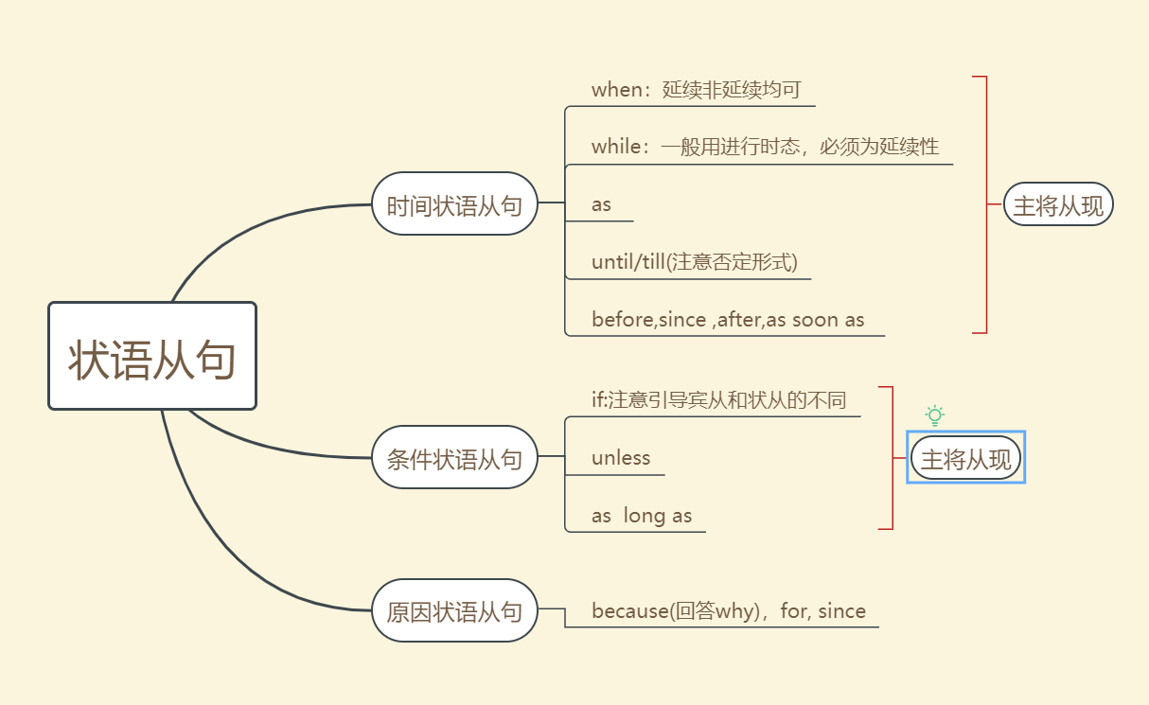

Slide 14
1,——When shall we go to watch the basketball match in the sports centre?
——Not until the work tomorrow.
A. will be finished B. is finished C. will finish D. has finished
答案 B
解析：考查时间状语从句和被动语态辨析。在时间状语从句中用- -般现在时表示将来,主语work与
谓语动词finish是逻辑上的被动关系,故选B。
2，——Nobody knows the new highway will be put into use soon.
——I bet it won't be long___ it has been completed already.
A. which; as B. when; since C. whether; since D. when; because
答案C
解析：考查宾语和状语从句。根据句意:没人知道新的高速公路是否很快会投入使用。可知第一个
空填whether引导宾语从句,第二个空填since引导状语从句,故选C。
4 ——Mum, __ shall we have lunch?
——We will have it when your dad ____ .
A. when; returns B. where; will return C. where; returns D. when; will return
答案：A
解析：考察疑问副词辨析和条件状语从句，根据答语是when引导的时间状语从句，得出问句问的应是我们什么时候吃午饭，时间状语从句遵循主将从现的原则，故选A。

Slide 15
感谢观看

